Slide 1
Kew Cottages
- Heritage Presentation -

Slide 2
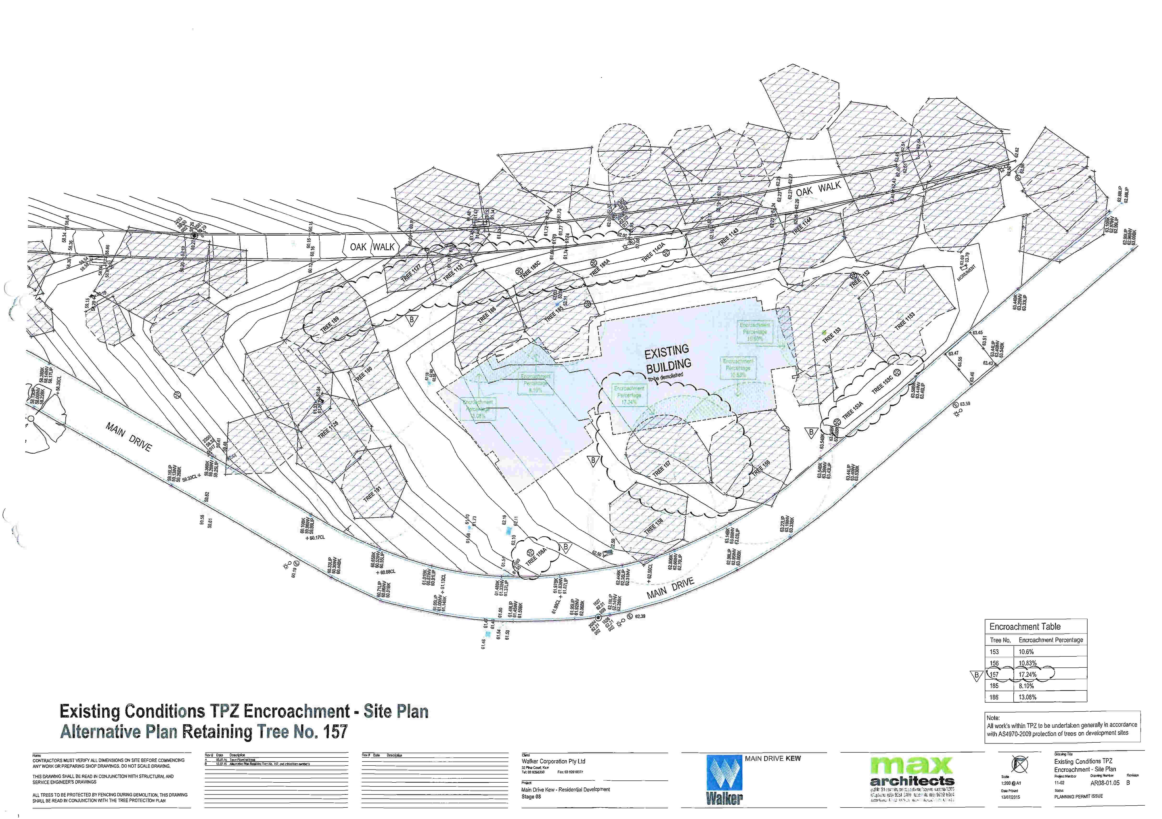

Slide 4
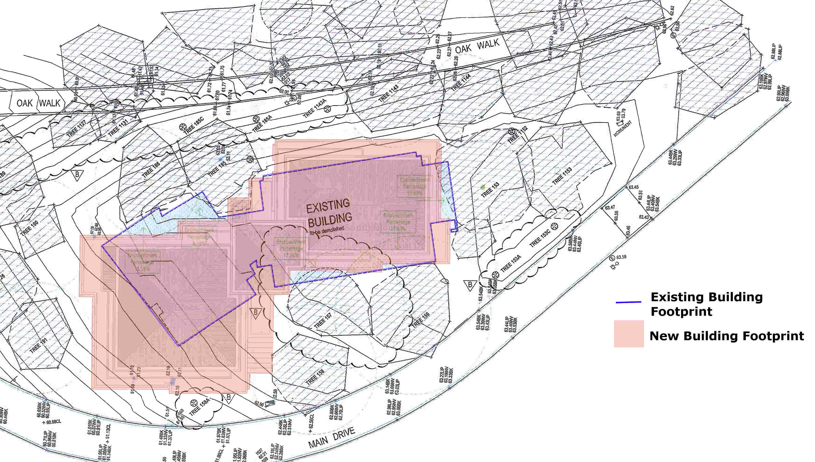

Slide 5
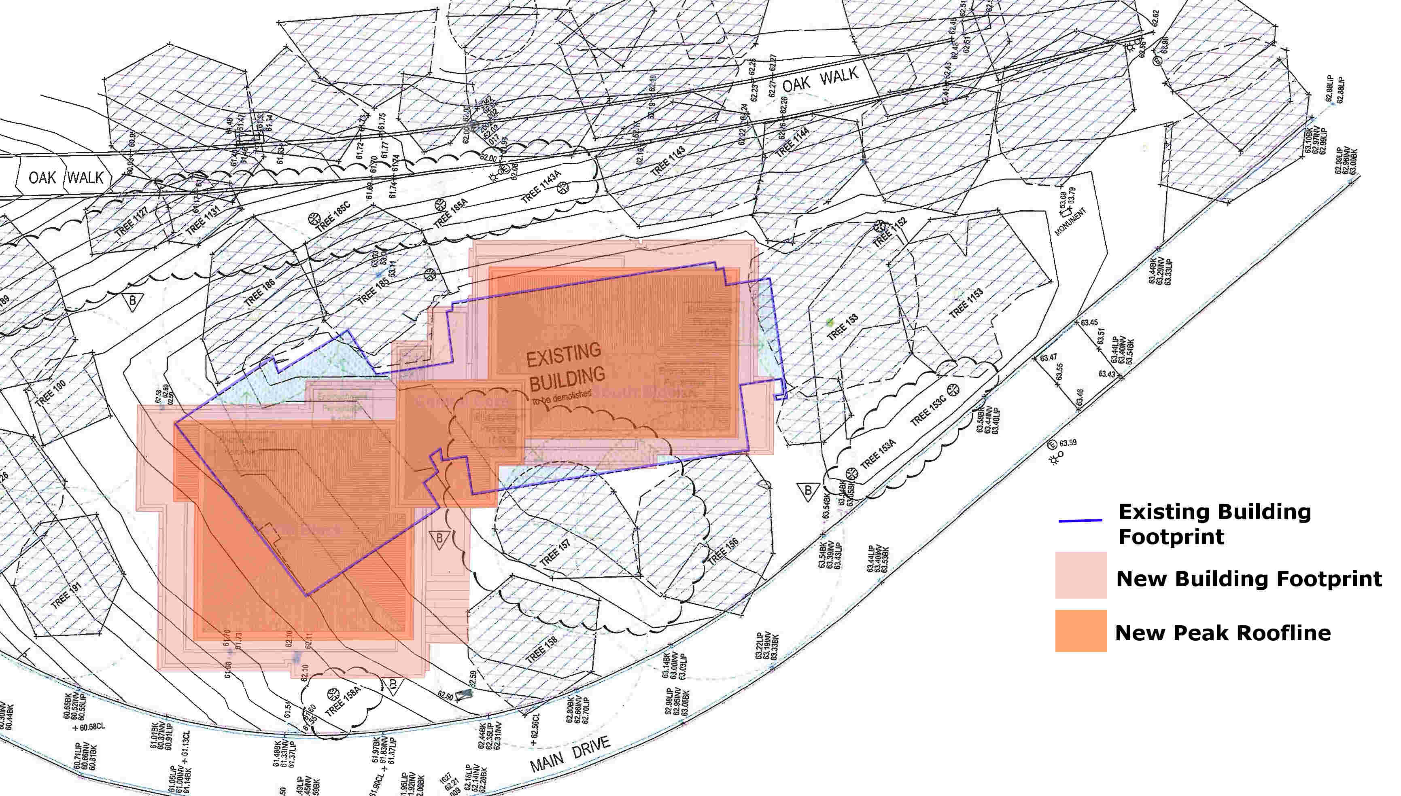

Slide 6
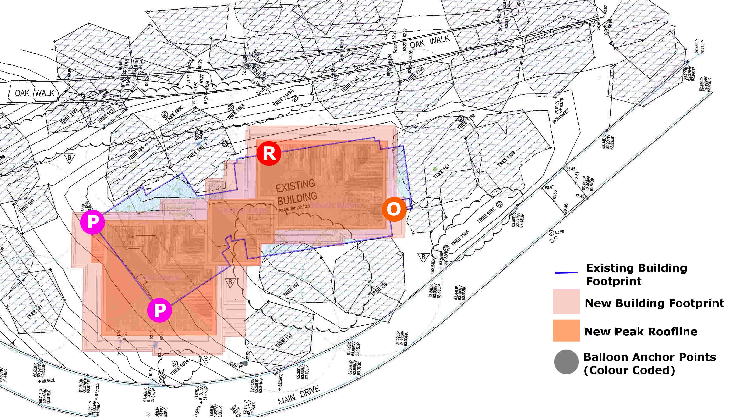
Balloon Config. 1
x4 0.9 Diameter Balloons

Slide 7

Balloon Config. 2
x4 0.9 Diameter Balloons

Slide 8
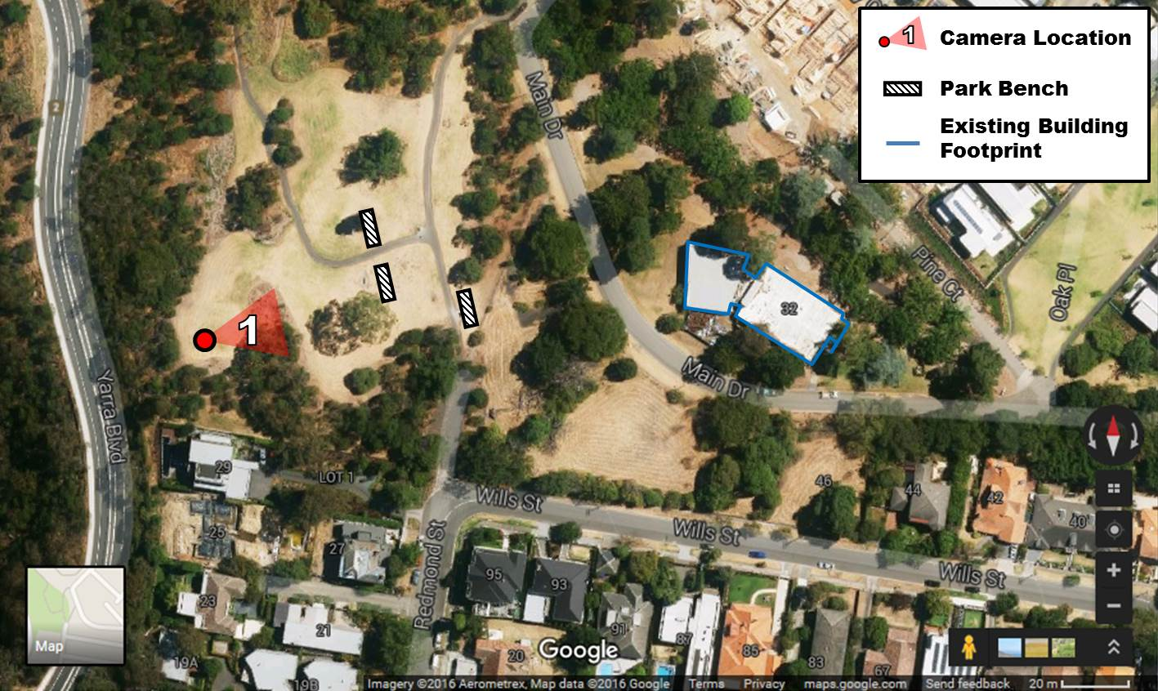
View 1 - Validation Case

Slide 9
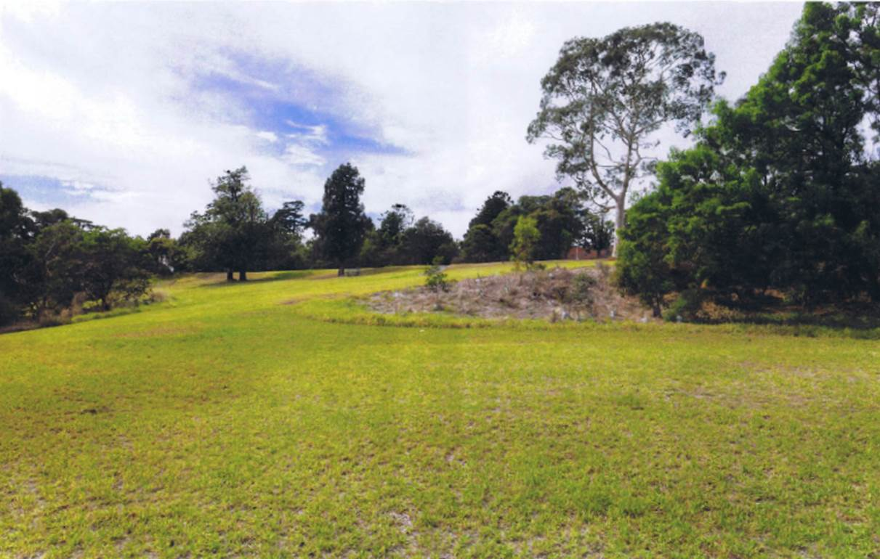
View 1 - Validation Case
Scharp Image V06A
1.7m, 22mm lens, 3.3° tilt

Slide 10
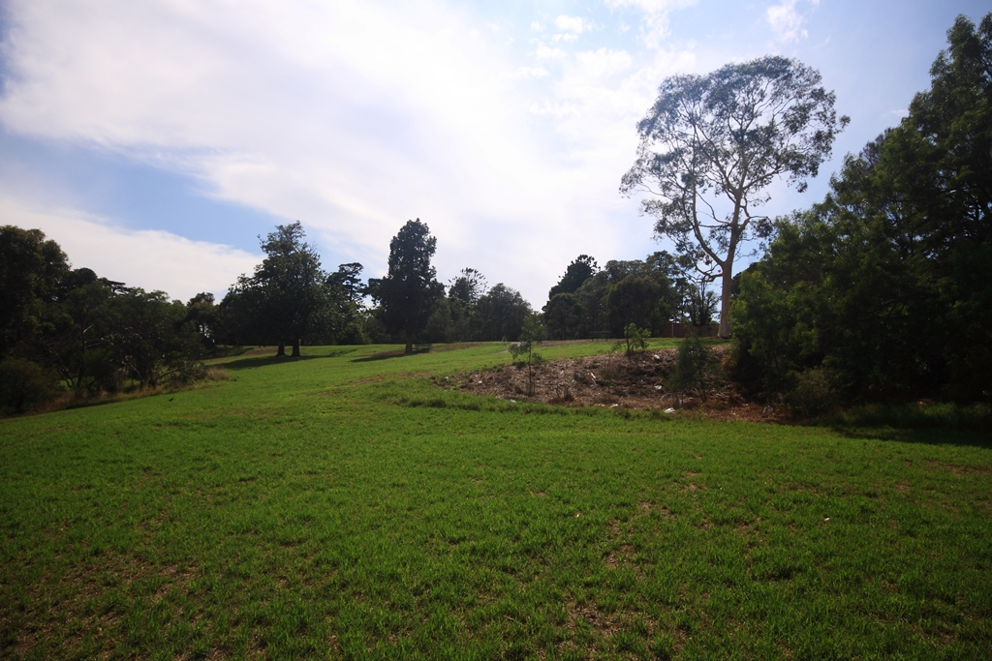
View 1 - Validation Case
1.7m, 22mm eq. lens

Slide 11

View 2 – Main Drive View

Slide 12
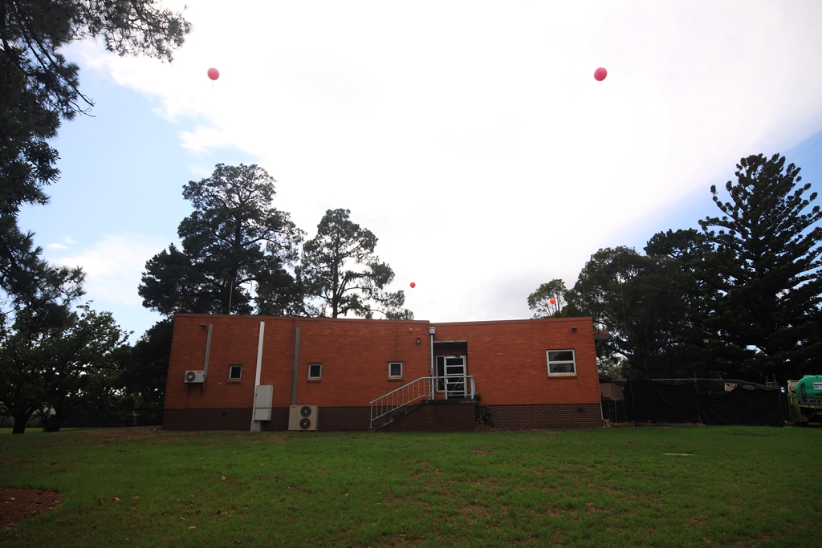
1.7m, 22mm eq. lens

Slide 13
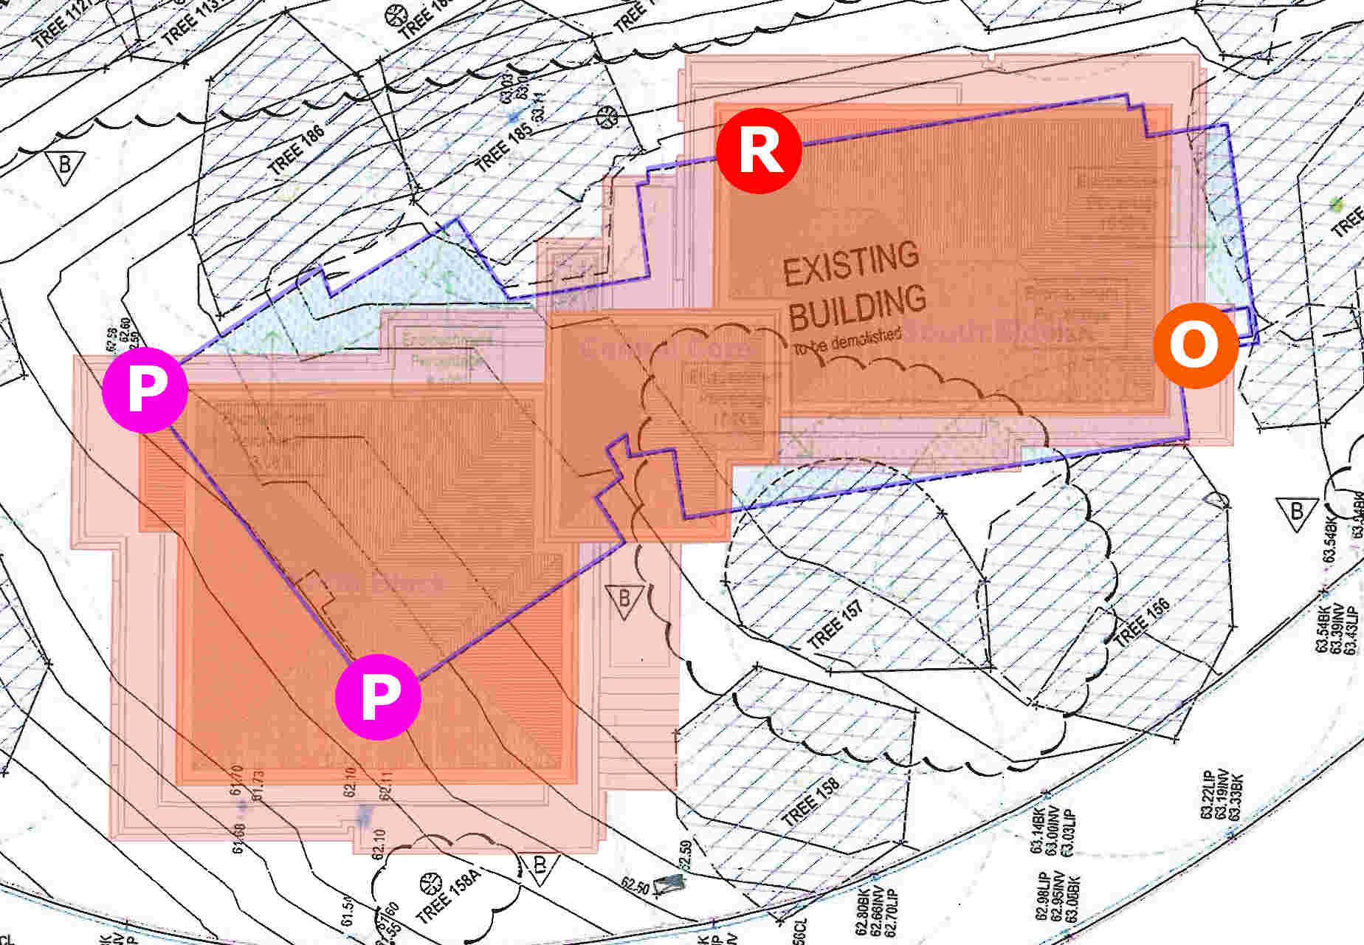
1.7m, 22mm eq. lens

Slide 14
1.7m, 22mm eq. lens

Slide 15
1.7m, 22mm eq. lens

Slide 16
1.7m, 22mm eq. lens

Slide 17

View 3 – Main Drive View #2

Slide 18
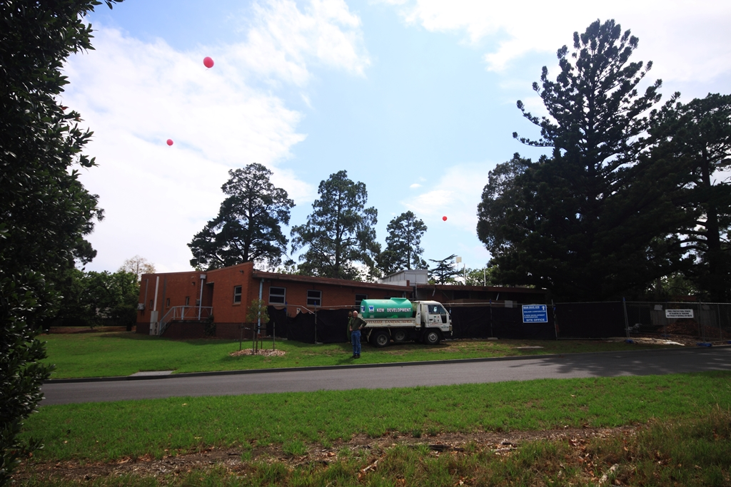
1.7m, 22mm eq. lens

Slide 19
1.7m, 22mm eq. lens

Slide 20
1.7m, 22mm eq. lens

Slide 21
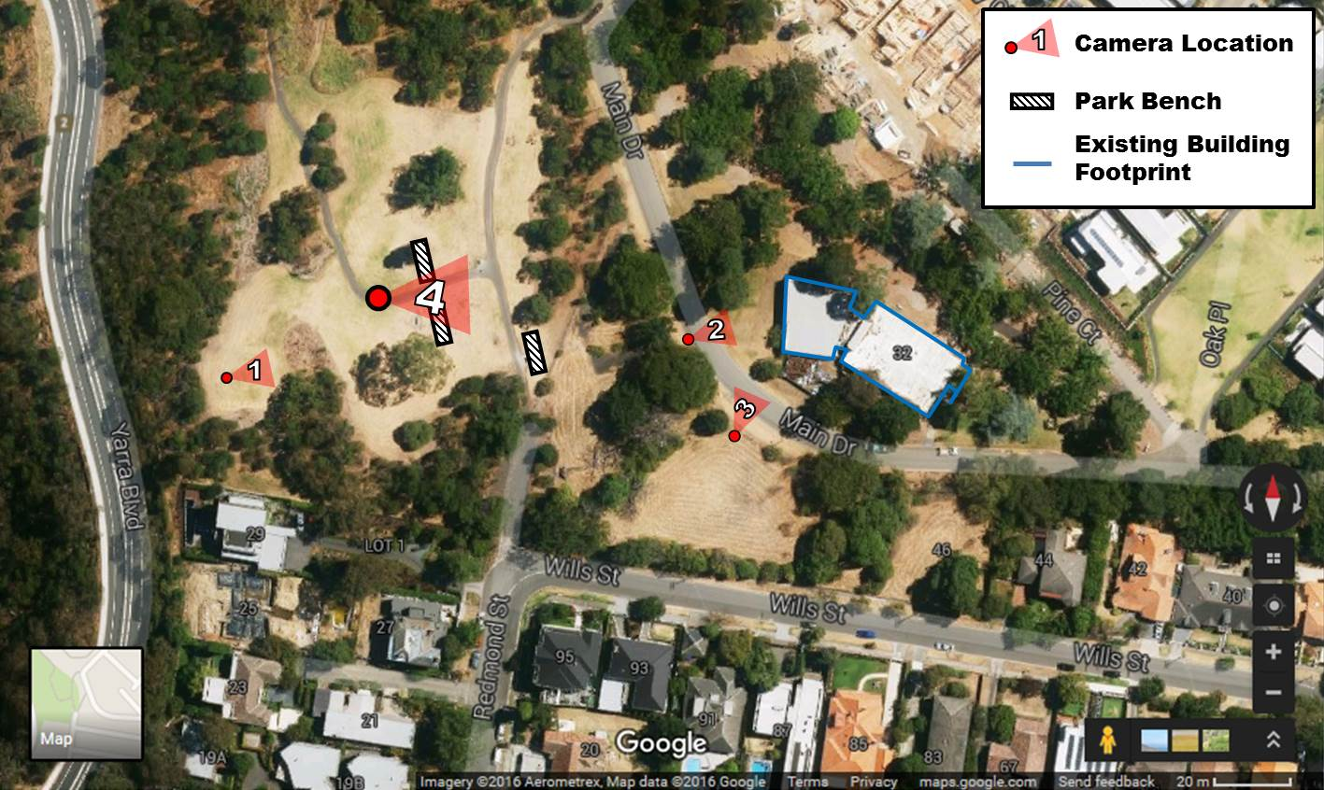
View 4 – The Park Path

Slide 22
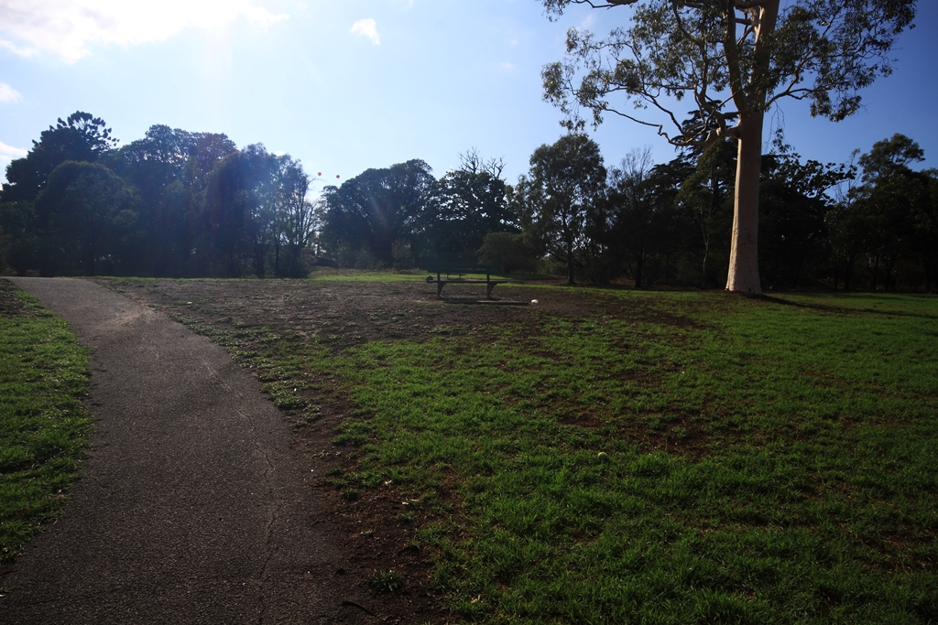
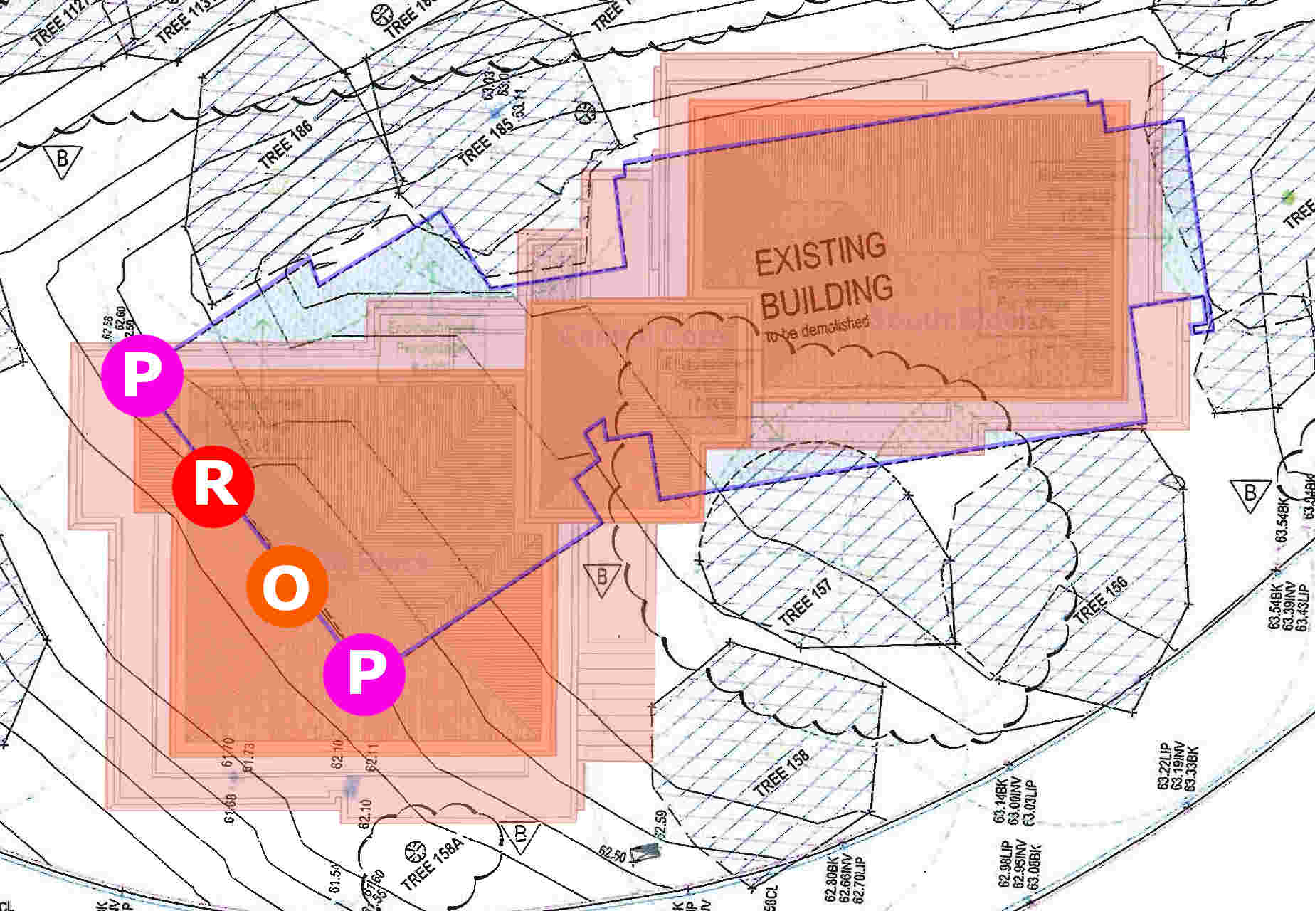
1.7m, 22mm eq. lens

Slide 23
1.7m, 22mm eq. lens

Slide 24
1.7m, 22mm eq. lens

Slide 25
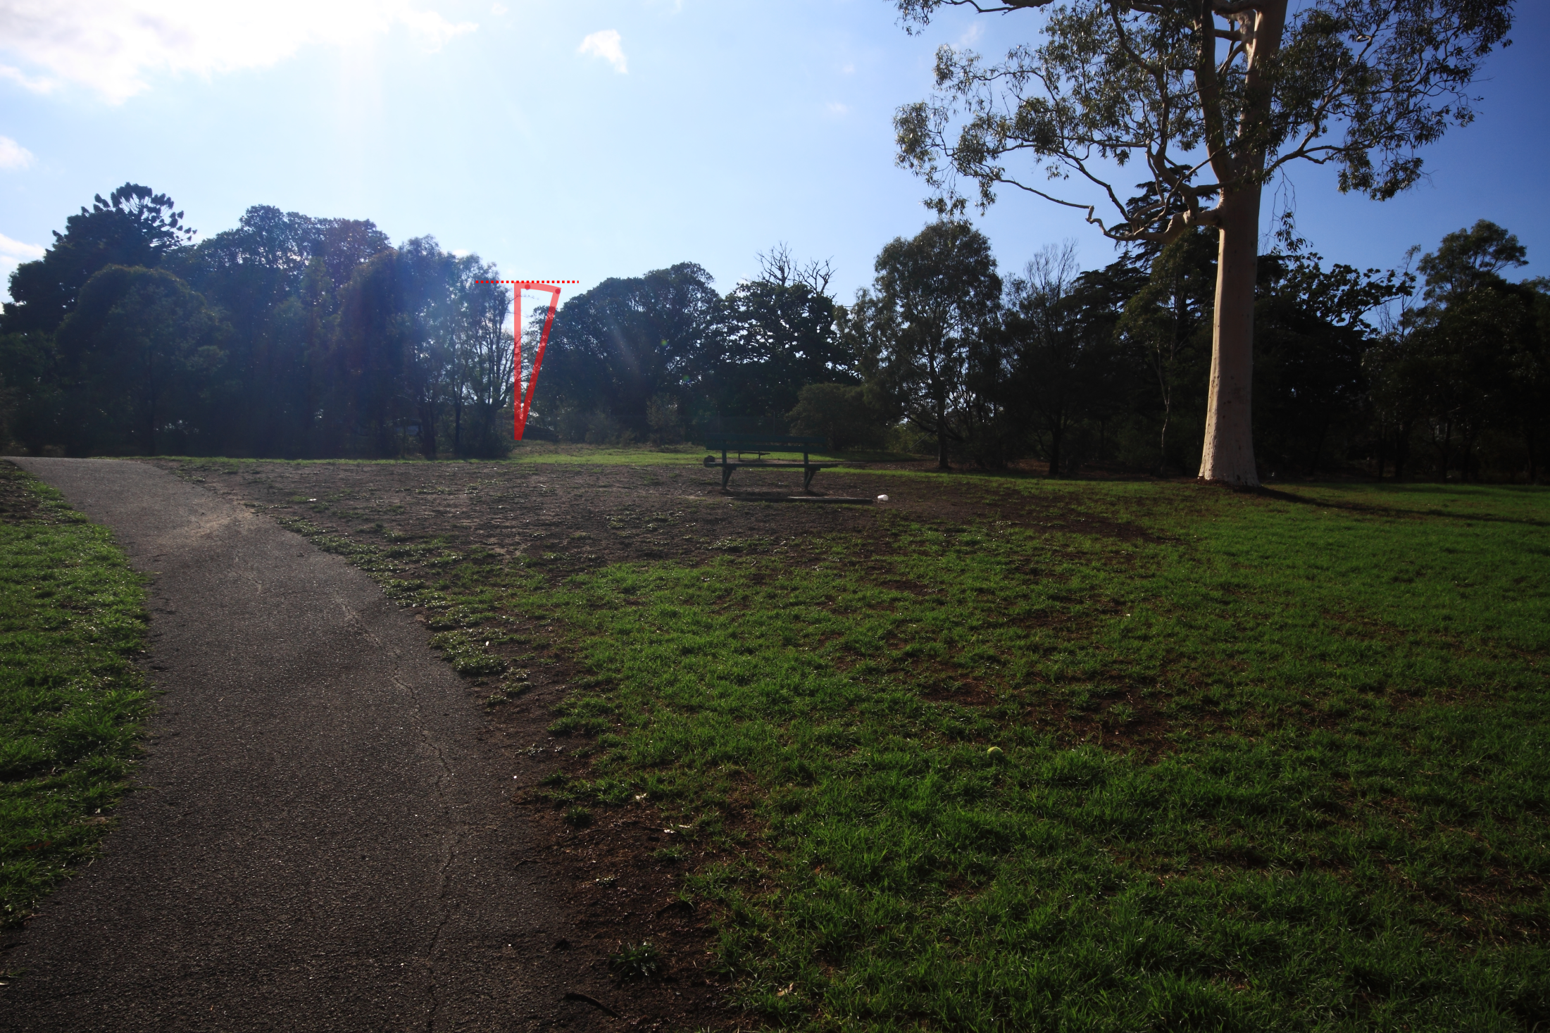
1.7m, 22mm eq. lens

Slide 26
Walker building outline
(estimated)
1.7m, 22mm eq. lens

Slide 27
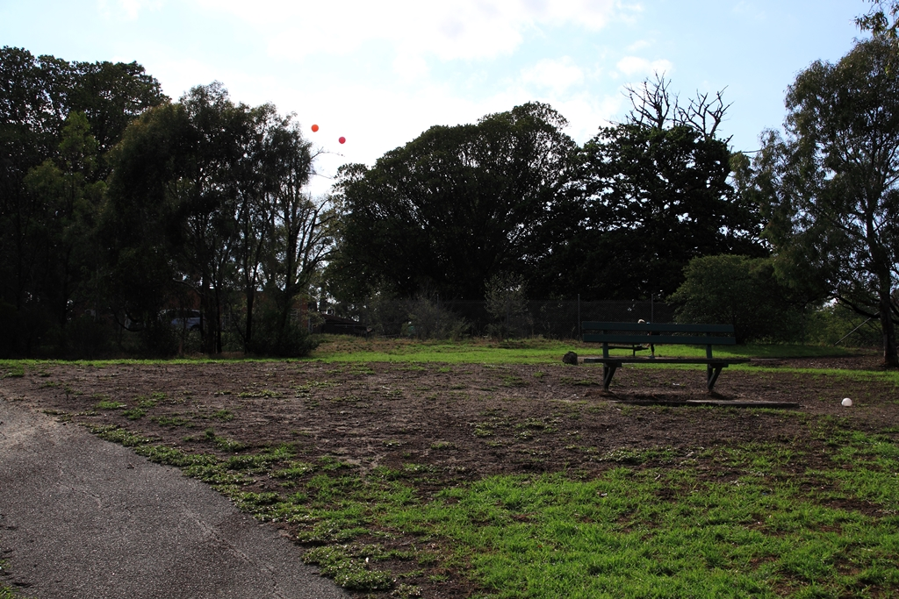
1.7m, 56mm eq. lens

Slide 28
1.7m, 56mm eq. lens

Slide 29
1.7m, 56mm eq. lens

Slide 30
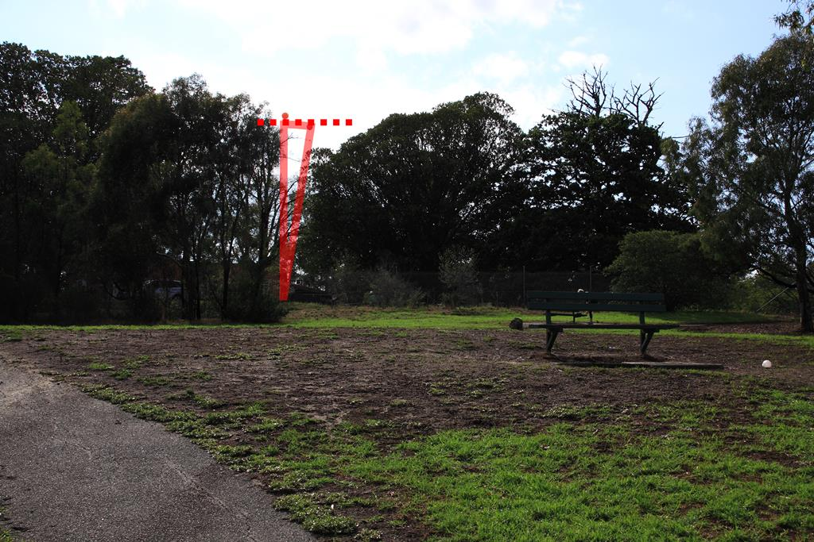
1.7m, 56mm eq. lens

Slide 31
Walker building outline
(estimated)
1.7m, 56mm eq. lens

Slide 32
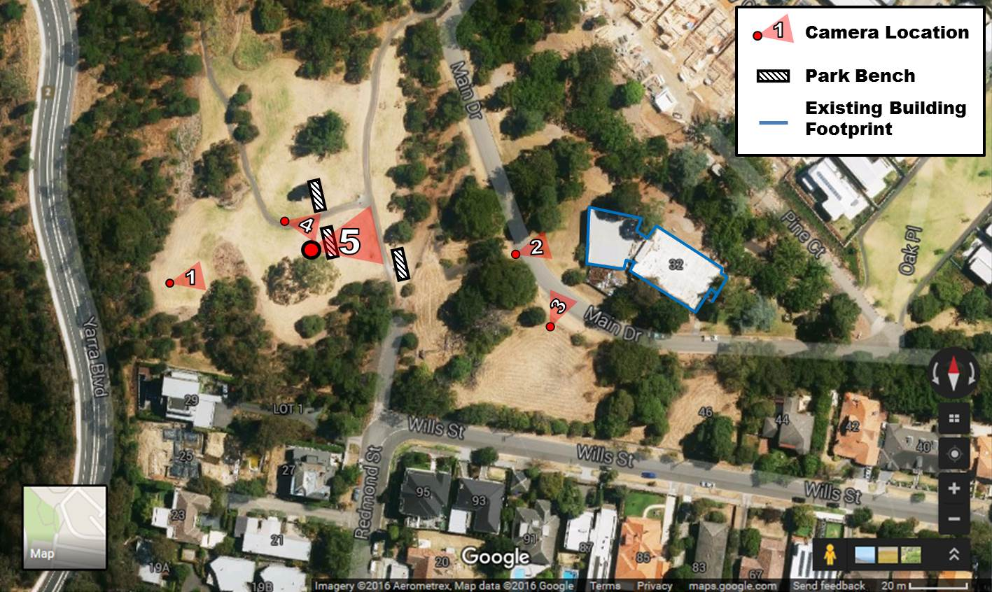
View 5 – The Park Bench

Slide 33
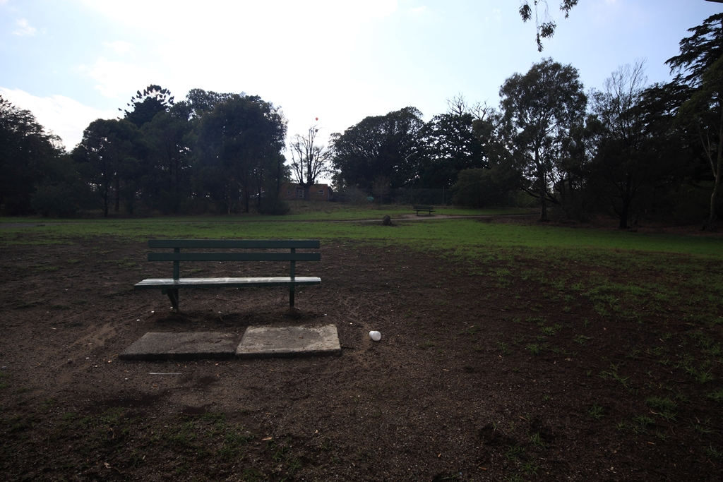
1.7m, 22mm eq. lens

Slide 34
1.7m, 22mm eq. lens

Slide 35
1.7m, 22mm eq. lens

Slide 36
1.7m, 22mm eq. lens

Slide 37
Walker building outline
(estimated)
1.7m, 22mm eq. lens

Slide 38
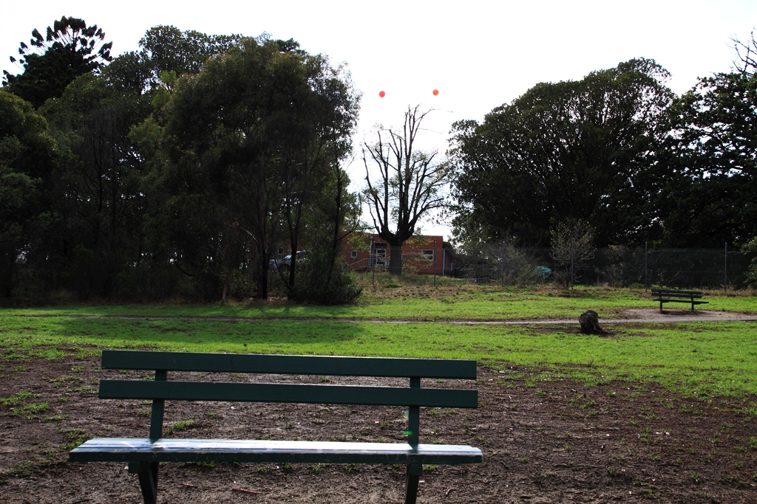
1.7m, 51mm eq. lens

Slide 39
1.7m, 51mm eq. lens

Slide 40
1.7m, 51mm eq. lens

Slide 41
1.7m, 51mm eq. lens

Slide 42
Walker building outline
(estimated)
1.7m, 51mm eq. lens

Slide 43

View 6 – Nearby Bench

Slide 44
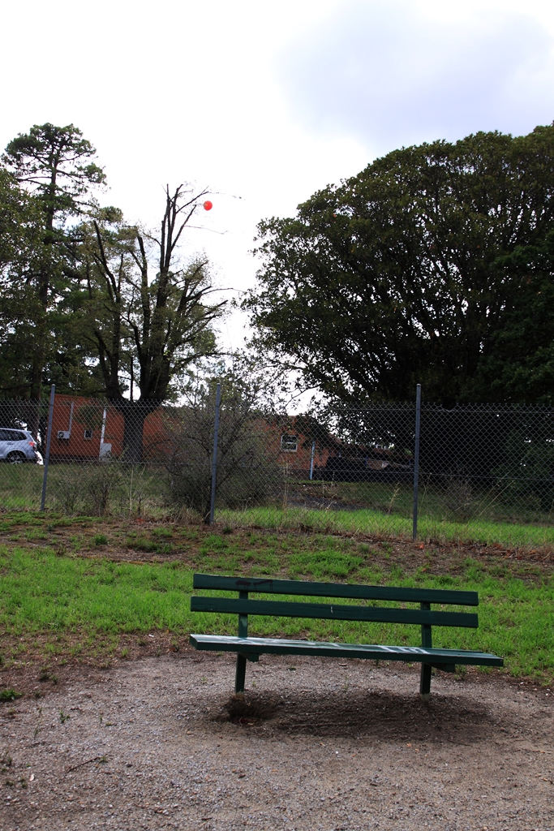
View 6 – Nearby Bench
1.7m,
51mm eq. lens

Slide 45
View 6 – Nearby Bench
1.7m,
51mm eq. lens

Slide 46
View 6 – Nearby Bench
1.7m,
51mm eq. lens

Slide 47
View 6 – Nearby Bench
Proposed building outline
(estimated)
1.7m,
51mm eq. lens

Slide 48
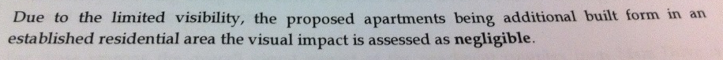
View 6 – Nearby Bench
Proposed building outline
(estimated)
1.7m,
51mm eq. lens

Slide 49
Thank You

